Slide 1
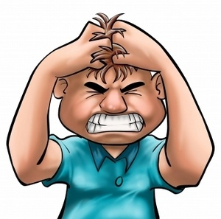
AGGRESSION

Slide 2
Perspective on Aggression
Biological Perspective : (Lorenz 1966 ; 1974)who suggested that aggression spring mainly from an inherited fight instinct. but most Social Psychologist reject this idea.
Human being aggressive against others in many different ways.
The frequency of aggressive action varies across human societies.

Slide 3
Perspective on Aggression
Driven theories:(Berkowitz 1984 ; 1989) these theorist propose that External conditions especially Frustration aroused is strong motive to harm others. they propose Frustration – aggression hypotheses.
but Social Psychologist have largely rejected this theory.

Slide 4
Perspective on Aggression
Social learning Perspective : (Anderson, Bushman 1994 ; 2002) this is modern theory of aggression with reasonable ideas that human beings are not born with a large array of aggressive responses at their disposal. Rather they must acquire these in the much the same way that they acquire other complex forms of social behavior: through direct experience or by observing the behavior of others LIKE,,,,,,,,,,,
Social models-live people or characters on television
Movies or even in video games

Slide 5

video games

Slide 6
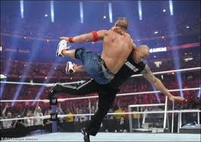
characters on television

Slide 7
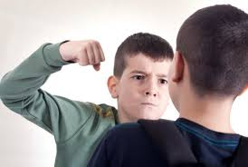
Social models-live people

Slide 8

Cartoon Movies

Slide 9
Aggression model(GAM)
Appraisal and decision process
Situational factors
Input variables
Personal factors
Thoughtful action
Current internal state
provocations
Negative affectivity
Affects
Cognition Arousal
Impulsive action Aggression

Slide 10
Aggression model(GAM)
Situational factors
Personal factors
Provocation
Frustration
Exposure to aggressive model
Causes of discomfort
Negative affects
Negative affectivity
Irritability
Beliefs about aggression
Pro-aggressive values
Type A behavior pattern
Hostile attribution base

Slide 11
Causes of Human Aggression
Social determination of Aggression:
Exposure to Media violence:
Culture factor in Aggression:
Personality and Aggression:
Situational determination of Aggression:
Workplace Aggression:

Slide 12
1- Social determination of Aggression
The words or deeds of other peoples provoke (anger, annoy, irritation)
Frustration: frustrated people always engage in some type of aggression and that all act of aggression, in turn, result of frustration. Bold statements like these are appealing but this doesn't imply that are necessarily accurate.
Instrumental: some people get aggressive because of instrument reasons ,,,, to get what they want and not because of intense frustration.

Slide 13
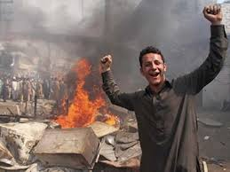
frustrated people always engage in some type of aggression

Slide 14
2-Exposure to Media violence
Exposure to Media violence: may indeed be one factor contributing to high level of violence in countries where such material are viewed by large number of people. Such effects are both short term and long term in nature.
Desensitization to violence: in other words as result of exposure to large amount of violence content in television programs, films, and video games individual become less sensitive to violence and its consequences.
Violence Pornography: mixture of sex and violence contained in such pornography can be dangerous and volatile one indeed.

Slide 15

individual become less sensitive to violence

Slide 16
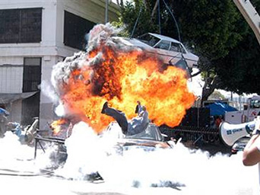
Suicide bombing news

Slide 17
3-Culture factor in Aggression
Aggression can also stem from cultural factors– beliefs, norms, and expectation in the given culture suggesting that aggression is appropriate or perhaps require under the certain circumstances.
Culture of Honor: culture in which there are strong norms indicating that aggression is an appropriate response to insult to one's honor. some time girls and boys killed or punished by the family and/or community for engaging in an interacts/interfaith relationship.

Slide 18
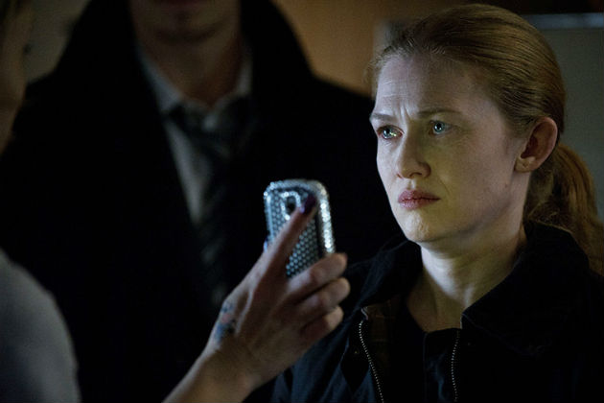
punished by the family

Slide 19
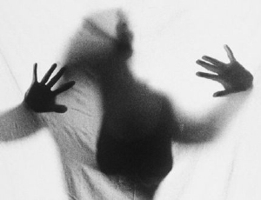
Honor killing like,,, Karoo Kari

Slide 20
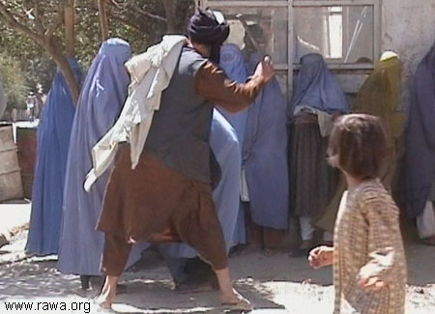
men take action to restore theirs honor

Slide 21
Conti,,,,
Sexual jealousy/Infidelity: real or imagined occurs in every society . its basically unfaithfulness with sexual partners. In some cultures infidelity by wife or lover is viewed as an ultimate insult to a male's honor,,,, so when men take action to restore theirs honor it is viewed as actually required.

Slide 22
4-Personality and Aggression
some people are prime for aggression by their personal characteristics , these characteristics , personality traits, aspects seem to play an important role in aggression with combination of situational factors.
Traits as sensitivities to provoking situation: this model suggest that many aspect of personality function in a threshold-like manner, only when situational factor are strong enough to trigger them do they influence behavior.
Traits as sensitivities to various situation: even weak provocation can stimulate for aggressive reaction.

Slide 23
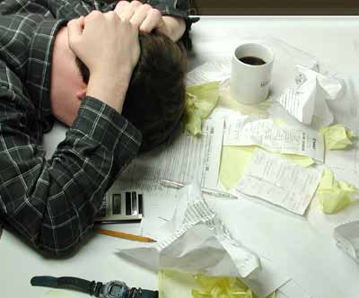
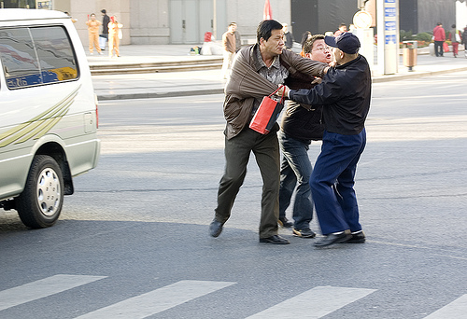
Conti,,,,,,,,
threshold-like manner
weak provocation

Slide 24
Conti,,,,,,,,,,,,
Personality type A: type A behavior pattern describe as extremely competitive, always in hurry, especially irritable and aggressive. (direct react)
they play an Hostile aggression in which the prime objective is inflicting some kind of harm on victim.
Personality type B: opposite end of type A is type B are not highly competitive, but more relaxed, not always fighting the clock, and who do remain calm even in the face of strong provocation.
they play an instrumental aggression primarily to attend other goals aside from harming the victim. such action as child abuse so spouse abuse. (indirect react)

Slide 25
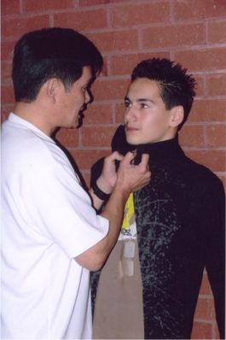
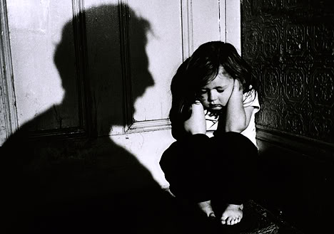
Personality type A and B
Type A Hostile aggression
B instrumental aggression

Slide 26
Conti,,,,,,
Traits of narcissism/ego threats: this traits refer to have excessive self-love, for holding an over inflated view of ones own virtues or accomplishment. these people highly in narcissism like ,
I am more capable, then other peoples.
They may react strongly even very mild provocation or mild critical comments, because they believe that they are much better then other peoples.

Slide 27
Conti,,,,,,,
Traits of Sensation seeking: this type of personalities gets bored easily, seeks lots of new experiences especially exciting ones with an element of risk, and general uninhabited, likely to impulsivity. Such people are prone to be more aggressive then others.
their Emotions are easily aroused and have lower level threshold for becoming aggressive, and lead to hostile thoughts.

Slide 28

exciting ones with an element of risk

Slide 29
Conti,,,,,,,
Gender difference in aggression:
Males report a high incidence of many aggressive behavior then do female. Males are more likely to engage in various forms of direct aggression like,,,, physical assaults, shouting, making insulting remarks.
Females in contrast involve in indirect aggression like,,,,
spreading vicious rumors, gossiping behind person back, making up stories to get them in trouble.

Slide 30
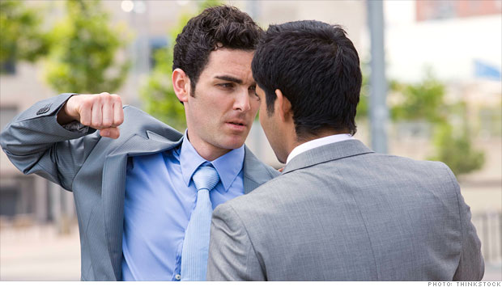
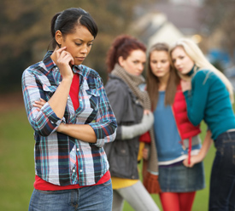
Gender difference in aggression
Males report direct aggression
Females involve in indirect aggression

Slide 31
5-Situational determination of Aggression
Aggression strongly influence by social and personality factors but situational is also important that in which in accurse , like,,,, heat and alcohol effects.
Heat increase aggression: on the bases of careful researches it is proved but only up to a point, boned some level, because temperature rise fatigue and uncomfortable condition that prone aggression.
Alcohol lower the threshold: for responding aggressively to provocation, alcohol impairs cognitive functioning for higher order such as evaluation of stimuli, memory, intentions and other behaviors including aggression.

Slide 32
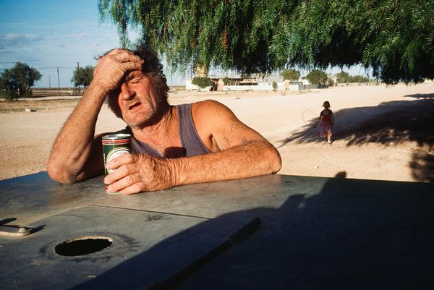
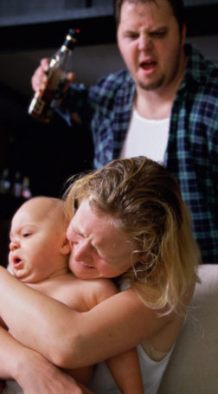
Situational Aggression
Heat and aggression
Alcohol and aggression

Slide 33
6-Workplace Aggression
Workplace aggression is any form of behavior through which individual seek to harm other in their work place.
Three types of expressions of hostile behaviors that are primarily verbal or symbolic in nature.
1- Obstructionism: create obstruct to transmit important and needed information, interfere in activates.
2- Incivility: violation of workplace norms for mutual respect, like sending rude E-mail, excluding from meetings, give hostile look, or stares, addressing inappropriate or unprofessionally.

Slide 34
Conti,,,,,,
3- Overt aggressive: in which employees attack other employees or their bosses.
included physical assault, theft, or destruction of property, threats of physical violence at workplace .
high risk profession such as ,,, taxi drivers, or police.
4-Abusive Supervision: teacher/senior who frequently shouted at you and others subordinates ,always seem to be in an irritable mood and evaluate you work in a totally unpredictable and unfair manners. this specific type of aggression is known as an aggressive supervision, damage not only employee but whole organization as well.

Slide 35

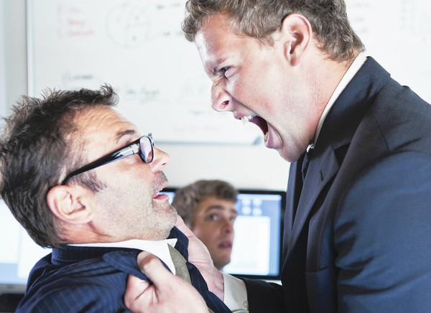
Workplace Aggression
React unprofessionally.
attack other employees.

Slide 36
Prevention and Control of Aggression(some useful techniques)
Punishment:
Self-Regulation:
Forgiveness:
Diversion:

Slide 37
Punishment:
delivery of aversive consequences is a major technique for reducing aggression people who are engaged in criminal or aggressive behavior receive Punishment
large fines
Put in prisons, and in some country are placed in
solitary confinement
physical punishments
there is widespread belief behind punishment that
such people deserved punish.
deter them or others to be engage again in future.

Slide 38

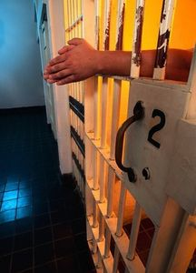
Punishment:
Put in prisons, large fines
criminal or aggressive behavior receive Punishment

Slide 39
Self-Regulation:
Self regulation required a lots of cognitive efforts, human beings have strong tendencies to aggress against others can yield beneficial outcomes, on the other hand living in a human society often required resist aggressive behavior.
when individual have positive attitudes towards regulating their emotions they may be able to restrain aggression almost effortlessly.
self-regulation is actually works like internal Mechanism.

Slide 40
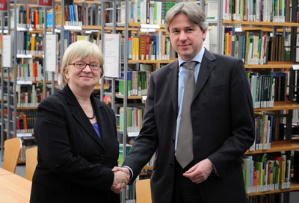

Self-Regulation:
society often required resist aggressive
tendencies to aggress beneficial outcomes

Slide 41
Conti,,,,,,,,
strengthen this internal mechanism of self regulating system against aggression, need some efforts,,,
Nonaggressive models: exposure to those people who show resistant even in the face of strong provocation.
Training: providing training designed to strengthen internal restraints.
Common sense: making a senses of common senses.

Slide 42
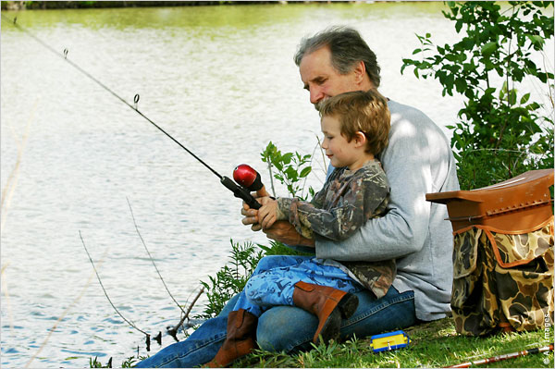
Nonaggressive models

Slide 43
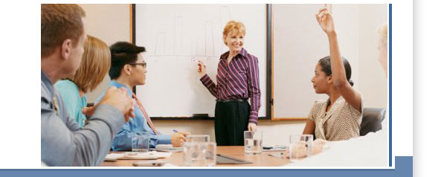
Training of anger management

Slide 44
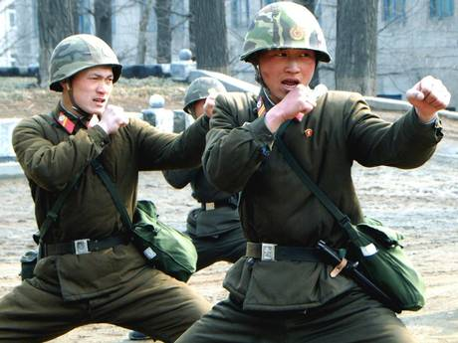
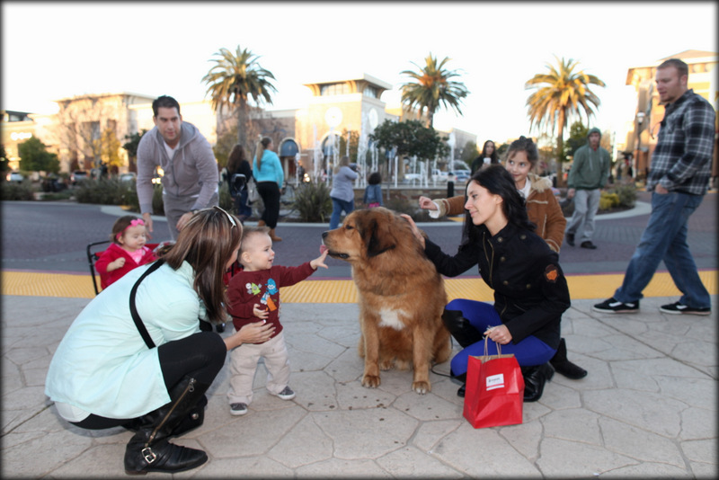
Training of anger management
Professional trainings
Social trainings

Slide 45
Training of anger management
Self statements
Preparing for provocation: (tray not to take it too seriously)
Confrontation: (there is no point to getting mad, it is really a shame that he has to act like this)
Coping with arousal: time to take a deep breathing, negative led to negative)
If coping successful: (I handled that one pretty it worked)
If coping remain unsuccessful: (I will get better at this as I get more practice)

Slide 46
Forgiveness:
Forgiveness is giving up the desire to punish some one or surrendering the desire for revenge who has hurted, may in and of itself be a useful step in terms reducing subsequent aggression.
Researches indicates that those in the forgiveness conditions reported higher self-esteem and lower level of negative affects then those in the no-forgiving condition.

Slide 47
Conti,,,,,,
Finding shows that befits of forgiveness are stronger for relationship
Social skill: forgiveness seem to a social skill that we should all tray to develop.
Benefits of letters and words: positive words enhance your psychological well being, greeting cards, acceptable messages, or attitude of forgiveness.
Empathy: tray to understand the feelings, emotions, and circumstances that cause the offending person to harm them.

Slide 48
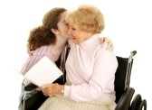

Forgiveness:
Empathy:
Benefits of letters and words

Slide 49
conversion:
Diversion (change position,, imagination, leave places…)
Positive self-talk (cool , calm , take it easy)
Sharing.
Writing.
Hobbies.
Socialization.
Empty chair technique.
Exercise or sports .
laughing (using humor)or/ tearing.
Deep breathing.
creative or productive activity.
Change environment temporarily.
Problem-solving skill

Slide 50
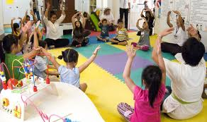
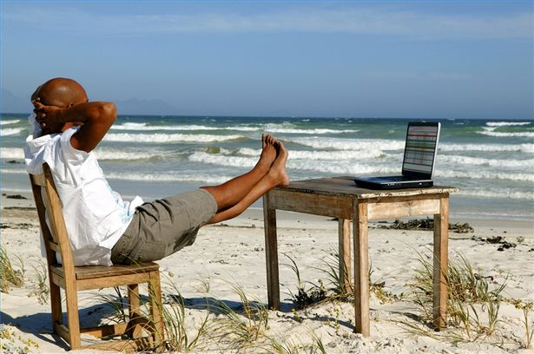
conversion:
creative or productive activity ,Socialization.
Change environment temporarily, Hobbies.

Slide 51
Thank you
Samara Rashid Khanzada
Rehab-Clinical Psychologist

